Slide 1
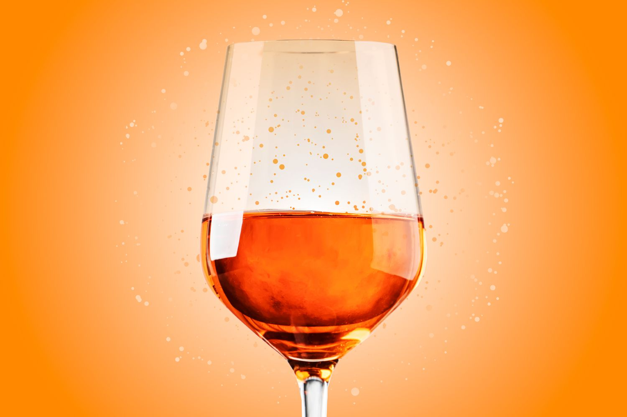
.
Wine Quality
This Photo by Unknown Author is licensed under CC BY

Slide 2
Objective and Scope of the Study
Define the purpose of the analysis
Understand wine quality factors
Identify key variables influencing quality
Establish boundaries and assumptions

Slide 3
Analytics Approach
Data collection + understanding
Data preprocessing
Exploratory Data Analysis (EDA)
Feature engineering
Modelling approach (if applicable)

Slide 4
Tools and Techniques
Python
Pandas, NumPy for data processing
Matplotlib, Seaborn for visualization
Scikit -learn for analytical methods
Jupyter Notebook

Slide 5
Visualization (EDA)
Distribution plots
Correlation heatmaps
Boxplots for outlier detection
Scatterplots for variable relationships
Trend analysis

Slide 6
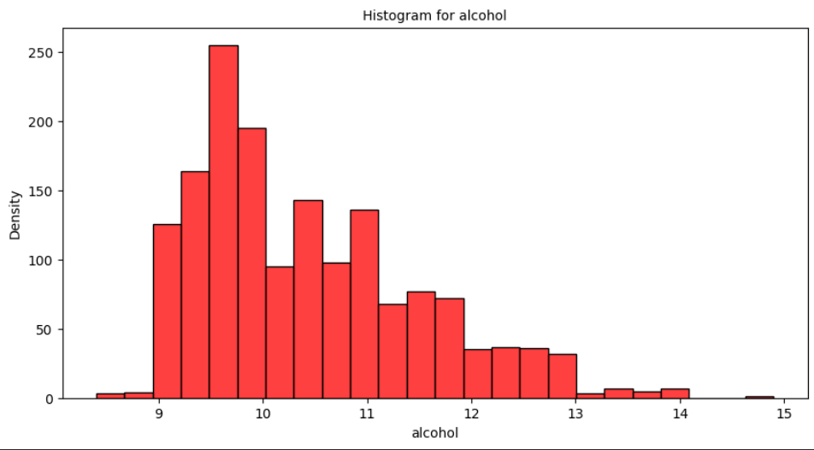
Histogram for alcohol
Shape: The histogram is positively skewed (right-skewed), indicating most data points are concentrated on the lower end of the alcohol scale
Peak: The highest density is around 9.5-10 on the alcohol scale.- Range: Alcohol values range approximately from 9 to 15
Density: Highest density is around 250, indicating a large concentration of data points between 9.5-10
Tail: There's a long tail extending towards higher alcohol values, indicating fewer data points at higher alcohol levels

Slide 7
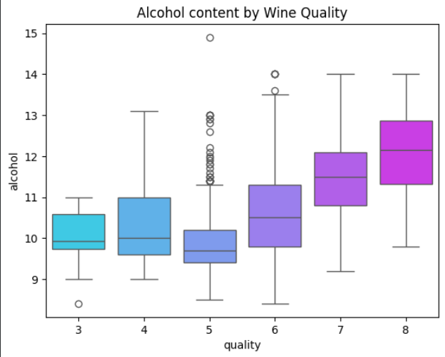
Alcohol Content by wine quality
Alcohol Content Trend: There's a general upward trend in alcohol content as wine quality increases from 3 to 8
Median Alcohol Content: - Quality 3 & 4: around 10% - Quality 5 & 6: slightly above 11% - Quality 7: around 12% - Quality 8: above 13%-
Variability: Higher quality wines (7 & 8) show more variability in alcohol content
Outliers: Some outliers are present, particularly in quality 5 wines.

Slide 8
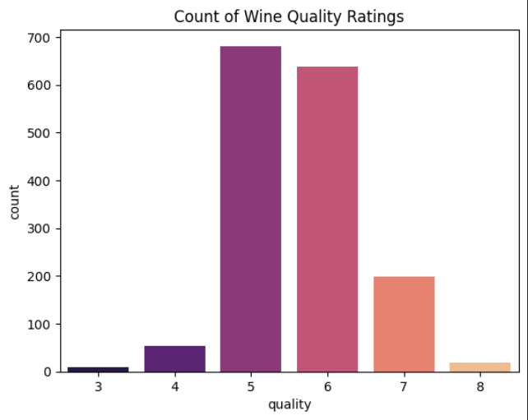
Count of wine quality ratings
Alcohol Content Trend: There's a general upward trend in alcohol content as wine quality increases from 3 to 8.
Median Alcohol Content: - Quality 3 & 4: around 10% - Quality 5 & 6: slightly above 11% - Quality 7: around 12% - Quality 8: above 13%-
Variability: Higher quality wines (7 & 8) show more variability in alcohol content.
Outliers: Some outliers are present, particularly in quality 5 wines.
Distribution: The boxes show a gradual shift towards higher alcohol content with increasing wine quality.

Slide 9
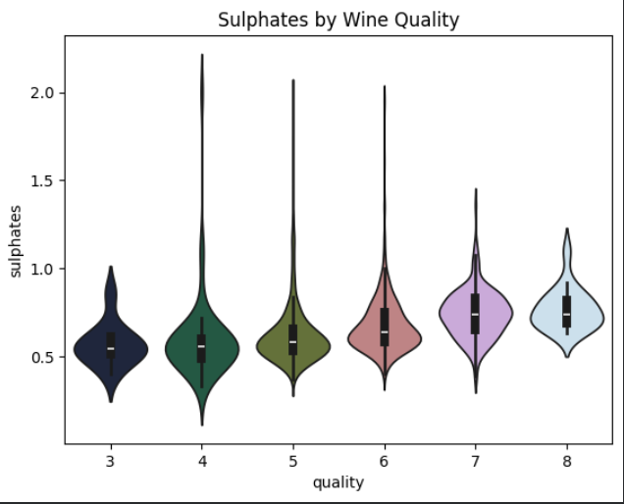
Sulphates by wine quality
Quality Ratings Distribution: The graph shows wine quality ratings ranging from 3 to 8
peak Ratings: Most wines are rated 5 and 6, indicating average to good quality.
Skewness: The distribution is roughly symmetric, leaning slightly towards lower-middle ratings.

Slide 10
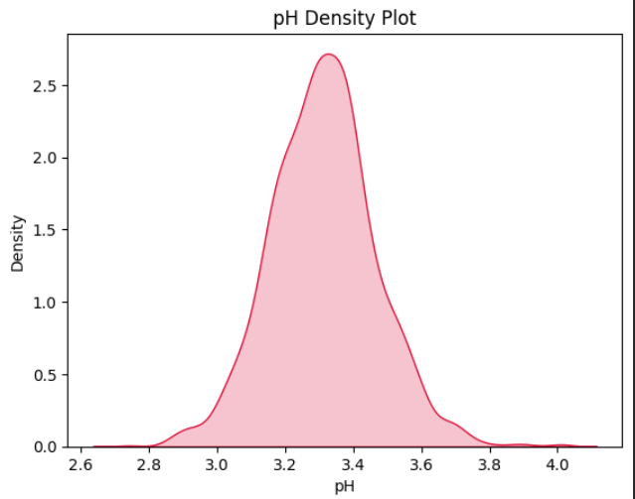
Ph density plot
The distribution is roughly symmetric around the peak.
The peak of the distribution is approximately at pH 3.4.
The pH values range from about 2.8 to 3.8, with most values clustering between 3.0 and 3.6.

Slide 11
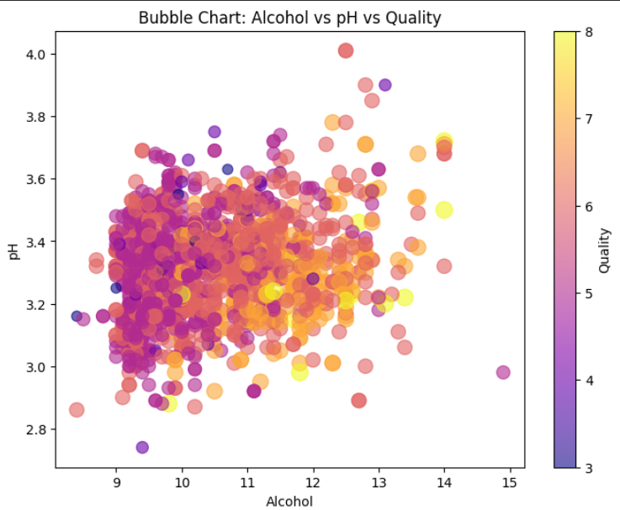
Bubble chart alcohol vs pH vs quality
Quality seems higher (yellow-orange bubbles) at moderate Alcohol levels (around 11-13) and mid-range pH (3.2-3.6): This suggests optimal quality might be associated with these ranges.
Lower pH and lower Alcohol show varied Quality (purple to red bubbles): There's a spread of quality scores at lower ends of Alcohol and pH, indicating possibly more variability in quality under these conditions.

Slide 12
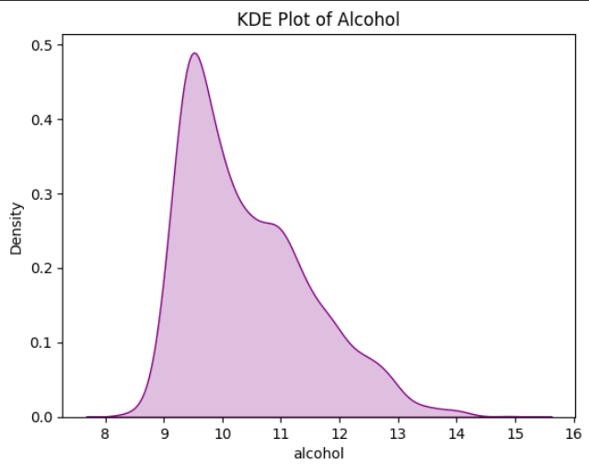
KDE plot of alcohol
Distribution Shape: The distribution appears to be right-skewed, indicating that most alcohol values cluster around the lower end (around 9-10), with a longer tail extending towards higher values.
Central Tendency: The peak density is around 9.5-10, suggesting this is where most data points are concentrated.-
Range: The data spans roughly from 8 to 15, with the majority of the density between 9 and 12.

Slide 13
Thank you

